Slide 1
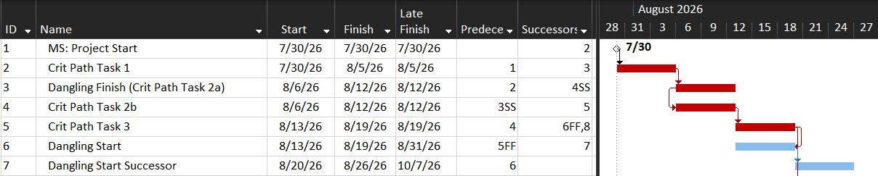
Jacked up Schedule 1: Dangling Tasks
Checking to see if it handles dangling tasks when checking for missing logic, as opposed to just counting blank Predecessor and blank Successor fields.
These were previously missing from logic metrics, but are now handled by DCMA’s DECMs and Acumen
Dangling/Missing Successor: Technically this has a successor, but the task itself does not drive anything to the right
Dangling/Missing Predecessor: Technically this has a predecessor, but the task itself has nothing pushing it from the left

Slide 2
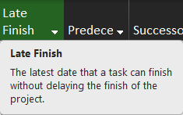
Jacked up Schedule 1: Dangling Finish
Ask the tool how late can Task 3 finish before it affects the end of the project. The way float is calculated in schedules is that it does a forward pass and backward pass to calculate Early Start and Early Finish dates and Late Start and Late Finish dates. This leads to Task 3 getting a Late Finish date of 8/12/26. But this task can actually never finish and it would be fine. I’m curious to see what the AI result says.
- It could check the Late Finish date and say 8/12/26
- It could say never
- The most correct response would be “if the tasks actual duration ends up being 5 days, then the latest it could finish is 8/12, but if it starts on time then it would never affect the project finish date”

Slide 3
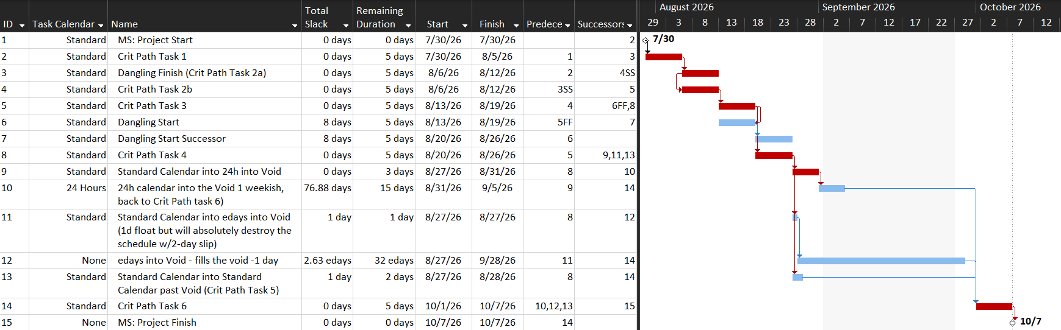
Jacked up Schedule 1: Multiple Calendars elapsed days (edays)
non-working time on Standard calendar
Overview of what’s going on:
Tasks on different calendars:
Standard calendar works Mon-Fri, 8am-5pm like default, except that the entire month of September is non-working time
24 Hours works Sun-Sat, 8am-8am: this calendar has no non-working time so it can work through September
edays ignores all calendars, so its Task Calendar is None (though you could technically assign a calendar that it would ignore)

Slide 4
Jacked up Schedule 1: Multiple Calendars elapsed days (edays)
Path 1:
Path 2:
Path 3:
Overview of what’s going on:
Task 8 branches off into three paths:
Path 1: Standard Calendar Task into 24 Hours Calendar task (which enters slightly into the September void)
Path 2: Standard Calendar Task into edays task (the edays task fills a lot of the September void, ends 9/28)
Path 3: Standard Calendar Task into Standard Calendar Task (1d of Total Slack built in)

Slide 5
Jacked up Schedule 1: Multiple Calendars elapsed days (edays)
Path 1:
Path 2:
Path 3:
Question 1: what is the critical path?
Path 1: 0d slack -> 76.88d slack -> 0d slack
Path 2: 1d slack -> 2.63edays slack -> 0d slack
Path 3: 1d slack -> 0d slack
Question 2: what does the AI analysis of the critical path say? I’m curious if it notices that task 11 is a ticking time bomb (if this task delays by 2d then the project finishes on time, if it slips by 3 days then the project is delayed by a month)

Slide 6
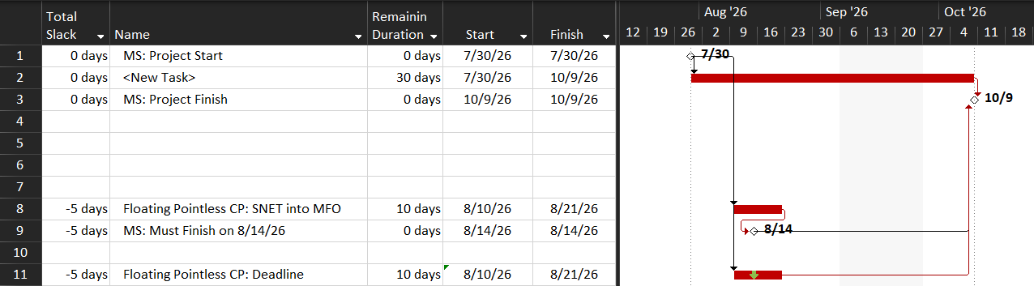
Jacked up Schedule 2
Here I’m just trying to see what it handles this with regard to the critical path. Technically, the critical path should be task 2
Task 8 has least Total Slack (-5d) because Must Finish On hard constraint. I’m guessing it will calculate this correctly, but will be interested to see how AI describes this
Task 11 has the same Total Slack (-5d) but only because of a deadline. I’m basically trying to see if it calculates Total Slack on its own (I think it does) and handles deadlines (an MS Project-specific field). If not, it’ll show that this task has 13d Total Slack.

